Slide 1
2025-02 AI psychophysics
Project proposal
2024710794 Hyerin Jang

Slide 2
Lucky Box Reversal
Task Purpose - Compare how the presence of loss/punishment (–1) versus null outcomes (0) influences learning and decision thresholds under changing environments (reversals).
Estimate differences between Humans vs LLMs in:
Loss aversion (λ)
Asymmetric learning rates (α⁺ / α⁻)
Stickiness (κ)
Exploration/temperature (τ)
+1
0
-1
0
-1
+1
Task Design
Two mystery boxes
Goal: collect Treasure (+1).
In some phases, the alternative outcome is Null (0), in others it is a Trap (–1).
At unpredictable points, the better box switches (reversal).

Slide 3
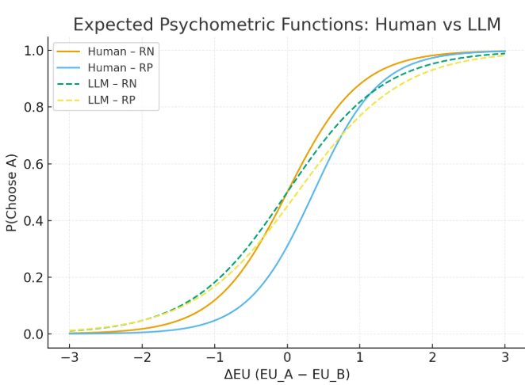


Key Measures
Psychometric curve:
P(Choose A) as a function of ΔQ or ΔEU
Reversal adaptation speed:
Half-life to reach correct choice after switch
Model parameters:
α+,α0,α−,τ,κ,γ + loss aversion λ
Behavioral indices:
Stay/switch rate
Probability of avoidance after negative outcomes
Human vs LLM Expected Results
Human:
Stronger leftward shift in RP (loss aversion, λ>1)
Higher slope (greater sensitivity to utility difference)
LLM:
Less affected by punishment (weaker shift)
Flatter slope (less sensitivity, more rule-like consistency)
Psychometric Function
X-axis (ΔEU): Difference in expected utility between Option A and Option B Y-axis: Probability of choosing Option A, modeled as a logistic function:
β0 ​: criterion / bias
β1 : sensitivity
Expected Pattern:
Both phases yield S-shaped curves.
In RP (Reward–Punish), the curve shifts left (more conservative criterion) and sensitivity may be reduced.
After a reversal, adaptation is slower in RP compared to RN.

Slide 4
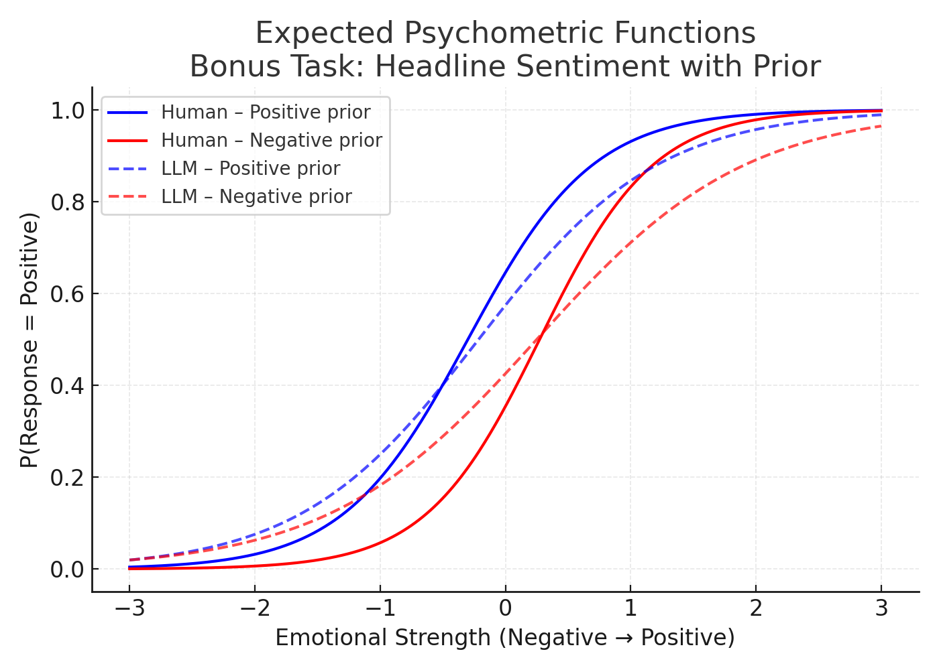

Expend : Headline Sentiment with Prior
Task Purpose To investigate how prior information (positive vs. negative expectation) influences the interpretation of ambiguous emotional sentences. This task captures interpretation bias and allows us to compare Humans vs. LLMs on how prior cues shift decision thresholds
Task Design
Each trial shows:
Prior cue (e.g., “People usually think this message is positive/negative”).
Ambiguous sentence with varying emotional strength (from negative → positive).
Response: binary classification (Positive / Negative).
Target Phenomenon & Analysis Plan
Target phenomenon: Prior cues shift decision bias (criterion β₀) and sensitivity (slope β₁).
Analysis plan: Fit logistic psychometric function
Compare β₀, β₁ across conditions (positive vs negative prior) and across species (Human vs LLM).
Expected Results
Humans: Stronger shift in β₀ under negative priors (negativity bias). S-curves move left with steeper slope.
LLMs: Less sensitive to priors; weaker shift of β₀; flatter slope (rule-like consistency).
Cross-task comparison : Participants showing stronger interpretation bias also show higher loss aversion (λ) and asymmetric learning (α⁻ > α⁺) in the main “Lucky Box Reversal” task.

